Slide 1

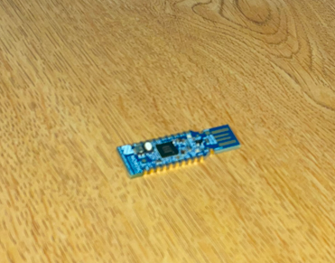
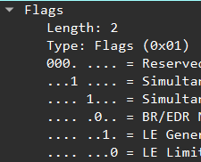
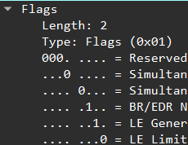
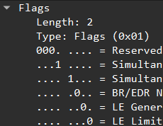
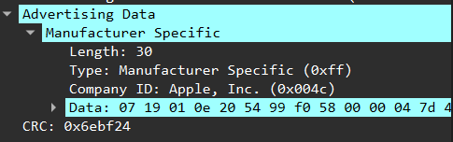
Low Energy Bluetooth
Fingerprinting & Patterns of Life Analysis
Faculty Sponsor: Dominick Foti
Frederick Berberich III
Introduction
Bluetooth low energy (BLE) are short-range wireless technologies that use public non encrypted advertising channels to announce their presence to other devices. BLE uses a MAC randomization protocol to protect devices from hackers.
Data Analysis
Various attributes found in BLE packets were proven to be quite useful when trying to track BLE devices through their MAC randomization protocol
Results
While some companies such as JBL have the device name public within the BLE broadcasting packet, companies such as Apple like to keep all their device’s information private and encrypted. This means we must find more ways to identify a device other than its device name. The first way is to see if a device has the flags attribute within its Advertising data section. If a device does not have any flags, there is a chance that it may be Bluetooth headphones. If it does, then it is a mobile device. Within the flags attribute itself, has 5 categories total but the main 3 to pay attention to are the Host, Controller, and BR/EDR Not Supported sections. They are labeled as enabled or disabled with a 1 or a 0. The flag attributes coming from a smartphone or smartwatch will have the values 1,1,0, laptops would be 0,0,1.
Device name: The name if device was named by a user
Company ID: A standard company code that each company that creates BLE devices associates with
Length: length of BLE section of packet
Power Level: What power level (measured in dBm) packet was detected as
RSSi: How far the packet was sent from the BLE dongle
Flags: Functions that are enabled for each specific BLE device
Methods
During the time of my research, the testbed included different generations of air pods, iPhone, and a JBL Flip 5 speaker to study the BLE packets. With the air pods still in the case, I would flip open the case so the device would start broadcasting. I would make sure my JBL speaker was on and connected to my iPhone, lastly, I would make sure my iPhone screen was on. I repeated these steps in a private area where the same stationary devices were in the area, so BLE packets from devices in a different area wouldn’t be picked up from the BLE dongle and cause some of the data to be different. After making sure all the devices were broadcasting, I would then set up each device to a specific RSSI number, so I can keep track of each device as the MAC address would change every 15 minutes. For the dongle, we decided to use Nordic Semiconductor’s BLE dongle. It’s called a nRF5280 dongle. Nordic created a Wireshark add-on that makes it relatively easy to use and receives an additional attribute from BLE packets called RSSI.
Image of nRF52840 Dongle
BLE packet from an iPhone
BLE packet from an Apple Watch
1
BLE packet from Air pods
Another identifier is a BLE packet's power level. A BLE packet's power level is the strength a packet was sent out. It’s measured in dBms and smartphones such as iPhone typically have a power level of 8 while smartwatches such as Apple watches have a power level of 9. You can identify a device based off of their packet length found in the Manufacturer Specific section. BLE headphones such as air pods almost always have a length of 30 while smartphones will have a length of 12 and smartwatches will have a length of 10. While manufacturer length is great for identifying headphones, it is not as trustworthy as smartphones and smartwatches because the length can change depending on what each device is transmitting.
iPhone, Android, & Apple Watch flags
Laptop Flags
Air pods length
JBL Speaker Flags
BLE packet from a JBL Flip 5 Speaker
BLE packet from a MacBook
Conclusion
Having additional understanding in Bluetooth Low Energy can be applied to make devices we use on a day-to-day basis communicate more securely, enhance our capability to monitor their communications, and identify those that are behaving outside of the norm. Overall being able to monitor Bluetooth Low Energy packets is a benefit to everyone.
(36” x 48” template)
Notes:
break up packet pictures within results text

Slide 2







